Slide 1


Logic circuits exercise 4
Ciurcău Leonardo-iulian
Group 911

Slide 2

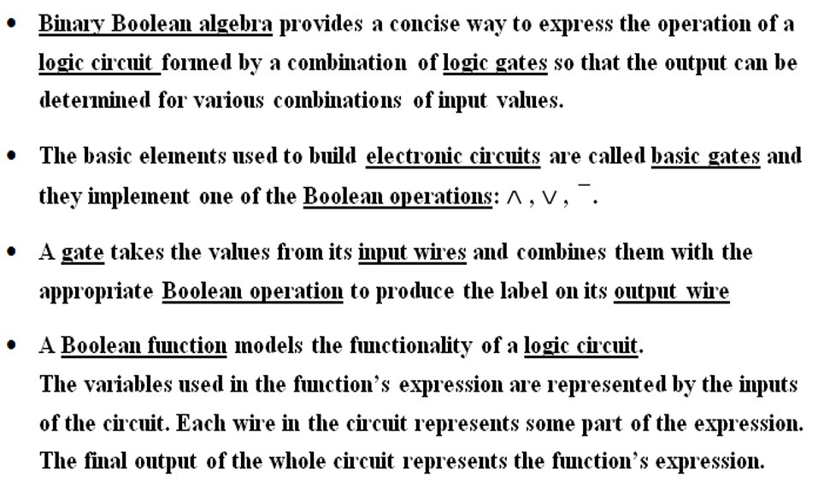



Logic Circuits Theory

Slide 3
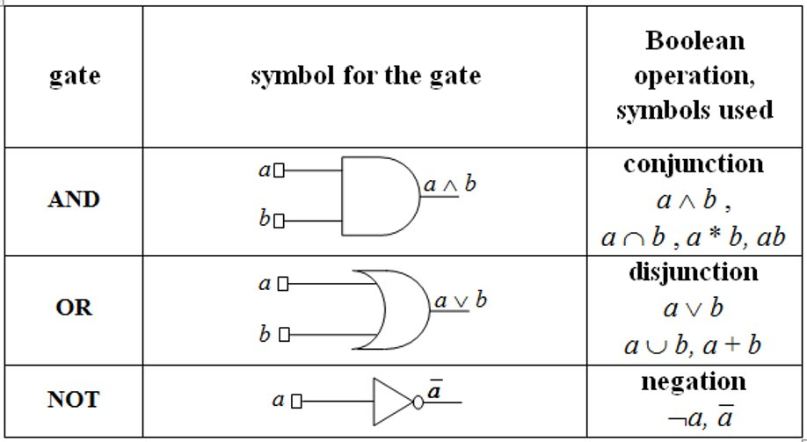
Basic Gates

Slide 4
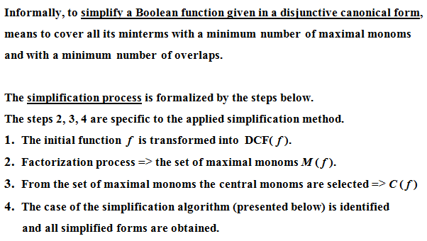
Simplification of Boolean Functions

Slide 5
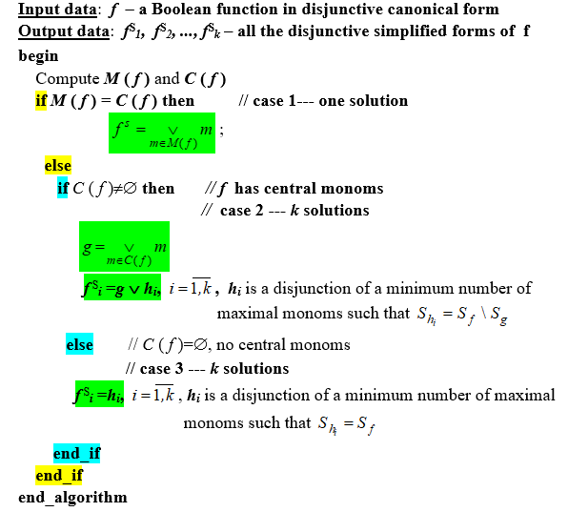
Simplification algorithm

Slide 6
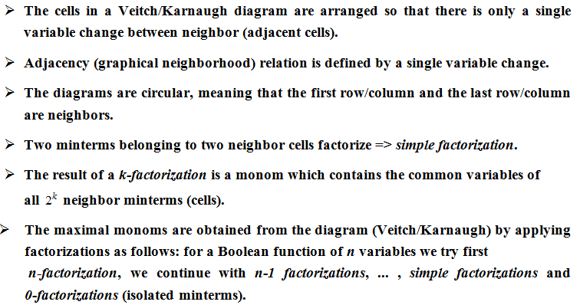
Veitch-Karnaugh Diagram Mehtod

Slide 7


Exercise 4
m | x1 | x2 | x3 | x4 | f
m0 | 0 | 0 | 0 | 0 | 0
m1 | 0 | 0 | 0 | 1 | 0
m2 | 0 | 0 | 1 | 0 | 0
m3 | 0 | 0 | 1 | 1 | 0
m4 | 0 | 1 | 0 | 0 | 0
m5 | 0 | 1 | 0 | 1 | 0
m6 | 0 | 1 | 1 | 0 | 0
m7 | 0 | 1 | 1 | 1 | 1
m8 | 1 | 0 | 0 | 0 | 0
m9 | 1 | 0 | 0 | 1 | 0
m10 | 1 | 0 | 1 | 0 | 1
m11 | 1 | 0 | 1 | 1 | 1
m12 | 1 | 1 | 0 | 0 | 0
m13 | 1 | 1 | 0 | 1 | 0
m14 | 1 | 1 | 1 | 0 | 1
m15 | 1 | 1 | 1 | 1 | 1
f(x1, x2, x3, x4) = m7 v m10 v m11 v m14 v m15
= $\overline{x1}$ x2 x3 x4 v x1 $\overline{x2}$ x3$\overline{x4}$ v x1 $\overline{x2}$ x3 x4 v x1 x2 x3 $\overline{x4}$ v x1 x2 x3 x4

Slide 8
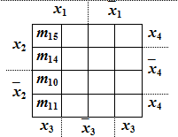
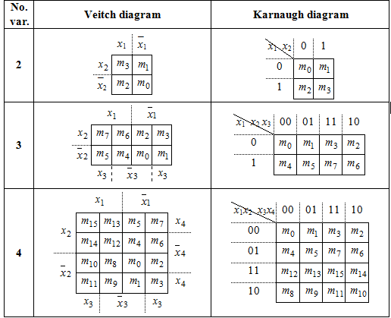
Veitch diagram

Slide 9

Simplification of the Boolean function
Set of maximal monoms:
M(f) = {max1, max2}
max1 = m10 v m11 v m14 v m15 = x1 x3 (double factorization)
max2 = m7 v m15 = x2 x3 x4 (simple factorization)
max1 is a central monom because it contains at least a midterm circled only once: m10, m11 and m14
max2 is a central monom because m7 is only circled once
=> all maximal monoms are central monoms => first case of the simplification algorithm
There is a unique simplified form of f, obtained as the disjunction of all central monoms:
$f^{s}$ = max1 v max2 = x1 x3 v x2 x3 x4

Slide 10
Conclusion Logic Circuit for f
x1
x2
x3
x4
x1
A
N
D
x1 x3
x3
O
R
f(x1, x2, x3, x4)
x2
A
N
D
x3
x2 x3 x4
x4

